Slide 1
Understanding and Calculating Average Rate of Change
College Algebra

Slide 2
First Example
Drive 200 miles in four hours
Average is 50 miles per hour
Add to this, but fundamental idea stays the same.

Slide 3
Average Rate of Change Mnemonic
Change in the outputs divided by change in the inputs

Slide 4
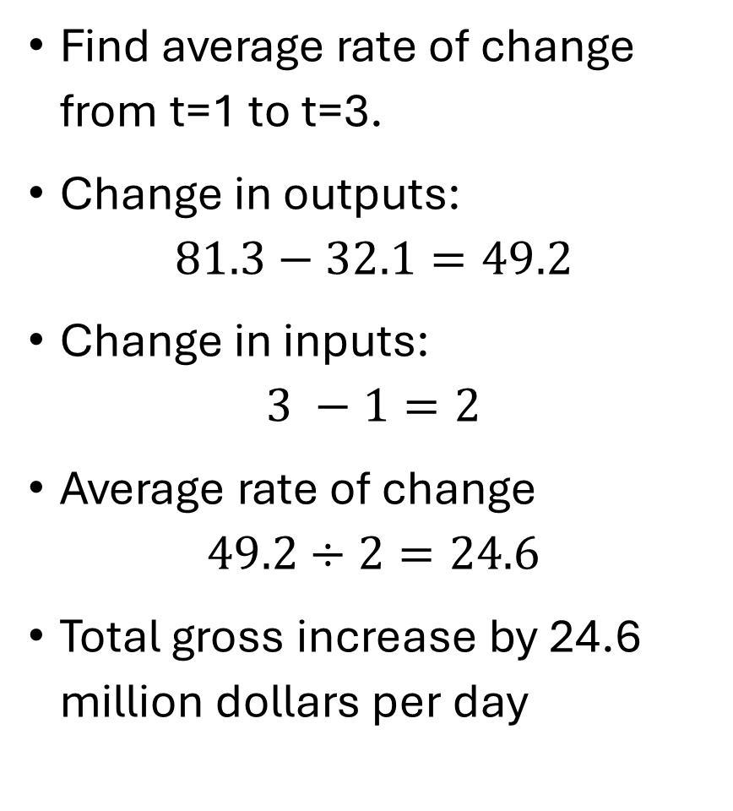
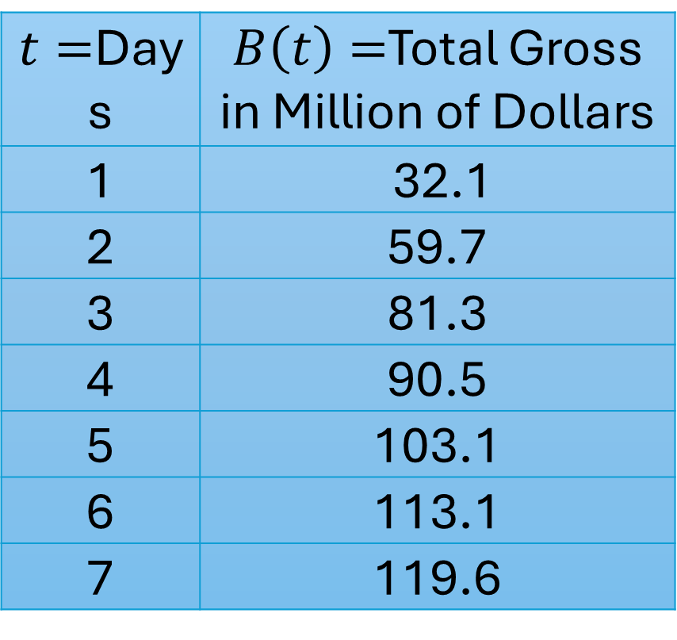
Example 1
Find average rate of change from t=1 to t=3.
Change in outputs: $81.3−32.1=49.2$
Change in inputs: $3 −1=2$
Average rate of change $49.2÷2=24.6$
Total gross increase by 24.6 million dollars per day
$t=$Days | $B\left(t\right)=$Total Gross in Million of Dollars
1 | 32.1
2 | 59.7
3 | 81.3
4 | 90.5
5 | 103.1
6 | 113.1
7 | 119.6

Slide 5
Units for Average Rate of Change
Units of average rate of change have the word “per”

Slide 6
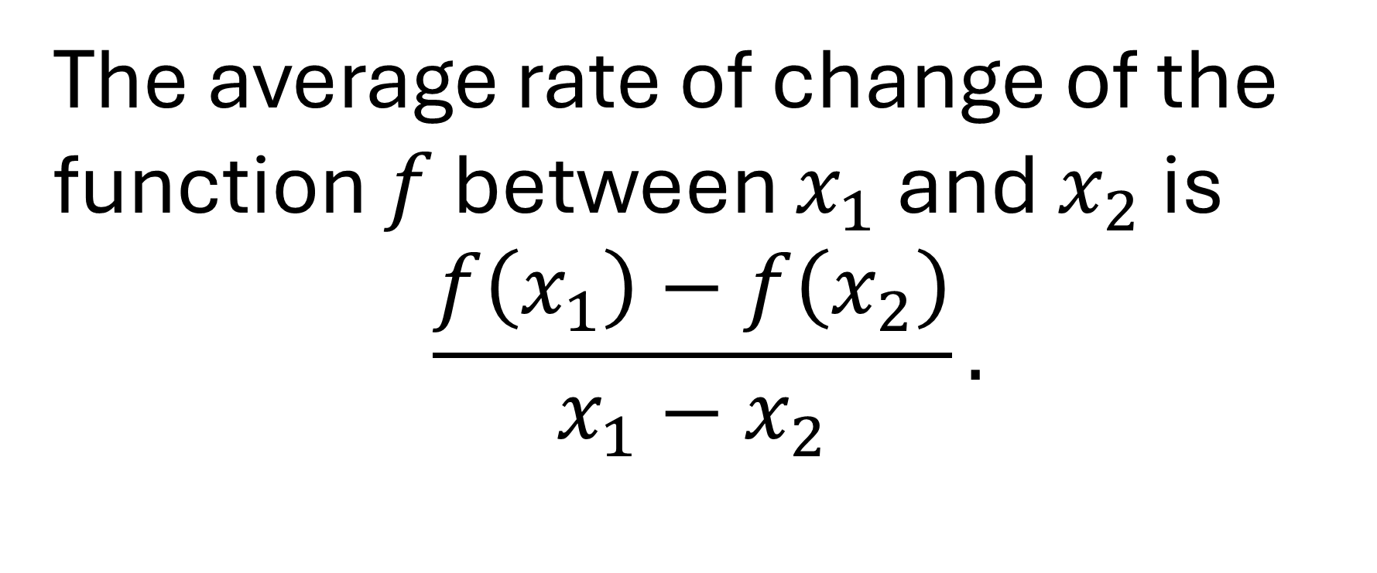
Average Rate of Change Formula
The average rate of change of the function $f$ between $x_{1}$ and $x_{2}$ is $$\frac{f\left(x_{1}\right)−f\left(x_{2}\right)}{x_{1}−x_{2}}.$$

Slide 7
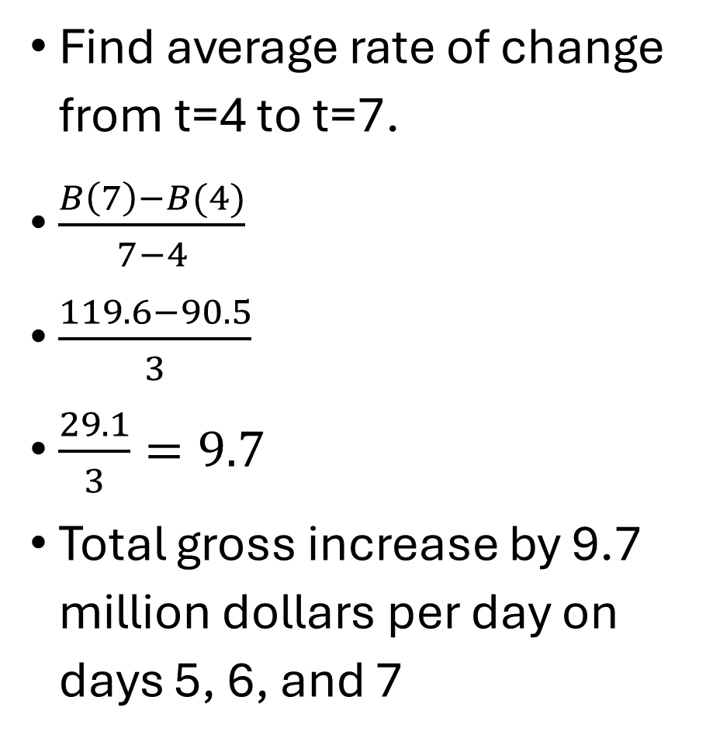
Example 2
Find average rate of change from t=4 to t=7.
$\frac{B\left(7\right)−B(4)}{7−4}$
$\frac{119.6−90.5}{3}$
$\frac{29.1}{3}=9.7$
Total gross increase by 9.7 million dollars per day on days 5, 6, and 7
$t=$Days | $B\left(t\right)=$Total Gross in Million of Dollars
1 | 32.1
2 | 59.7
3 | 81.3
4 | 90.5
5 | 103.1
6 | 113.1
7 | 119.6

Slide 8

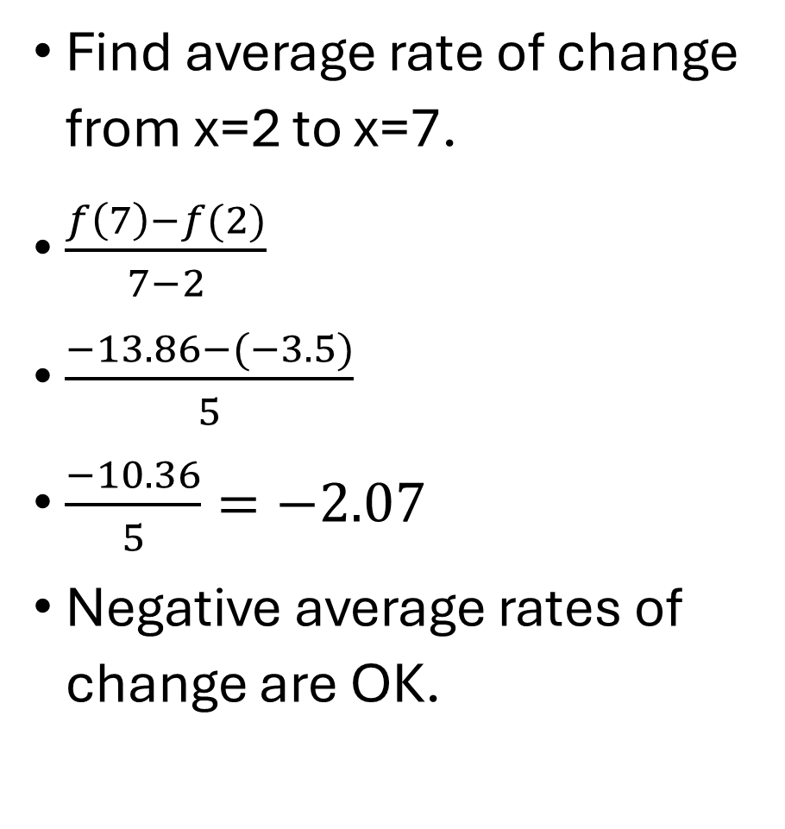
Example 3
Find average rate of change from x=2 to x=7.
$\frac{f\left(7\right)−f(2)}{7−2}$
$\frac{−13.86−(−3.5)}{5}$
$\frac{−10.36}{5}=−2.07$
Negative average rates of change are OK.
$$f\left(x\right)=\frac{1}{x}−2x$$

